Slide 1

SEMINAR
ON
Fusion of infrared and visible images through a hybrid multi-scale decomposition with Gaussian and bilateral filters
Presented
By
SHIVPRASAD ACHARI
1DS13CS091
Under the Guidance of:
Dr. Shubha Bhat and Prof. Shashidhara Bola
Dept of Computer Science & Engineering
Department of Computer Science & Engineering, DSCE

Slide 2
OVERVIEW
The presentation would deal with the following
Introduction
Literature survey
Methodology
Experiments and Results
Conclusion
References
Department of Computer Science & Engineering, DSCE

Slide 3
INTRODUCTION
Infrared(IR) and visible image fusion is an important technique in multi-sensor information fusion applications.
Since IR sensors are able to capture thermal information in a scene that is not directly seen by human eyes, they can more clearly detect some objects in lowlight, occlusion and adverse weather conditions.
Visible imagery normally provides more details of the scene in the visible spectrum, and also presents more natural intensities and contrasts that are consistent with human visual perception.
In this project, we present a multi scale fusion method to achieve better fusion results for human visual perception.
Department of Computer Science & Engineering, DSCE

Slide 4
l
LITERATURE SURVEY
In this paper, we present a multi-scale fusion method based on a hybrid MSD transform (hybrid-MSD) to achieve better fusion results for human visual perception.
The hybrid-MSD decomposes the source image into texture details and edge features at multiple scales by jointly using multi-scale Gaussian and bilateral filters.
A more common approach for pixel-level image fusion is con-ducted in gray scale space based on various multi-scale decomposition (MSD) transforms, e.g., Laplacian pyramid (LAP)[4] gradient pyramid (GP) [5], wavelet transform [6] and support vector transform [7].
Our method manages to employ the hybrid-MSD to inject the important IR spectral features into the visible image, Thus , it would lead to perceptually better fusion results for human interpretation.
Department of Computer Science & Engineering, DSCE

Slide 5
‘;l
METHODOLOGY
The proposed approach comprises of two steps:
1. Infrared and visible image fusion based on the hybrid - MSD
1.1.Small and large-scale combinations.
1.2.Base level combination.
Department of Computer Science & Engineering, DSCE

Slide 6
2. Infrared and visible image fusion based on the hybrid - MSD
Visible images often contain more fine-scale details than the corresponding infrared images, in which the thermal information is usually captured.
Therefore, there usually exists a large scale difference between the infrared and visible images.
In addition, infrared images often present unnaturally high contrasts and intensities on the objects with relatively higher temperature than the surroundings.
For these reasons, decomposing and then merging the two source image information directly by employing conventional MSDs without reliable feature selection may not produce a pleasant fusion result for human observation.
Department of Computer Science & Engineering, DSCE

Slide 7
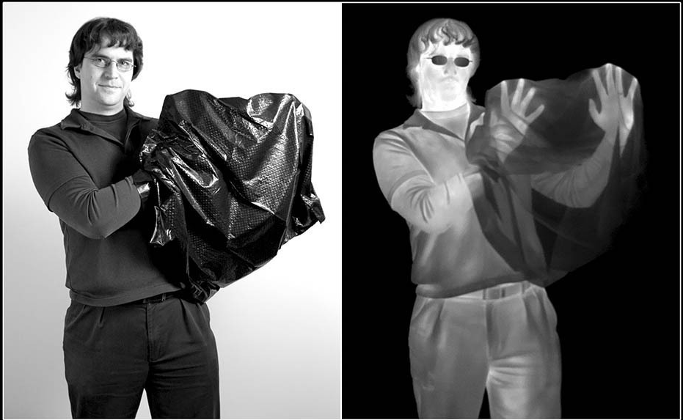
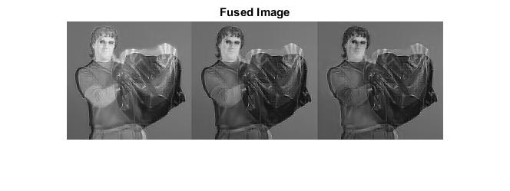

Slide 8
Gaussian and bilateral filters
Gaussian and bilateral filters are both known as important filtering methods used in image processing applications. The Gaussian filter is one of the basic tools for noise reduction and image smoothing.
Noise is the result of errors in the image that result in pixel values that do not reflect the true intensities of the real scene.
Gaussian smoothing is used as a pre-processing stage in computer vision algorithms in order to enhance image structures at different scales see scale space representation and scale space implementation.
A bilateral filter is a non-linear, edge-preserving and noise-reducing smoothing filter for images. The intensity value at each pixel in an image is replaced by a weighted average of intensity values from nearby pixels.
Department of Computer Science & Engineering, DSCE

Slide 9
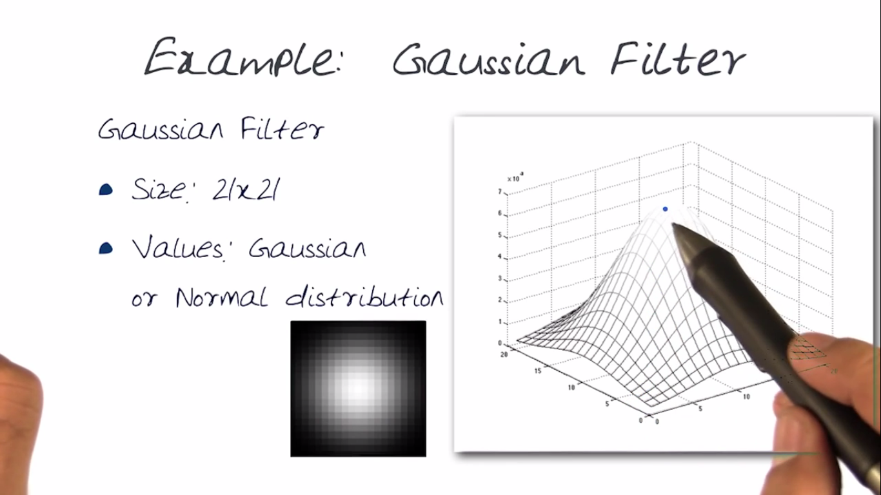

Slide 10
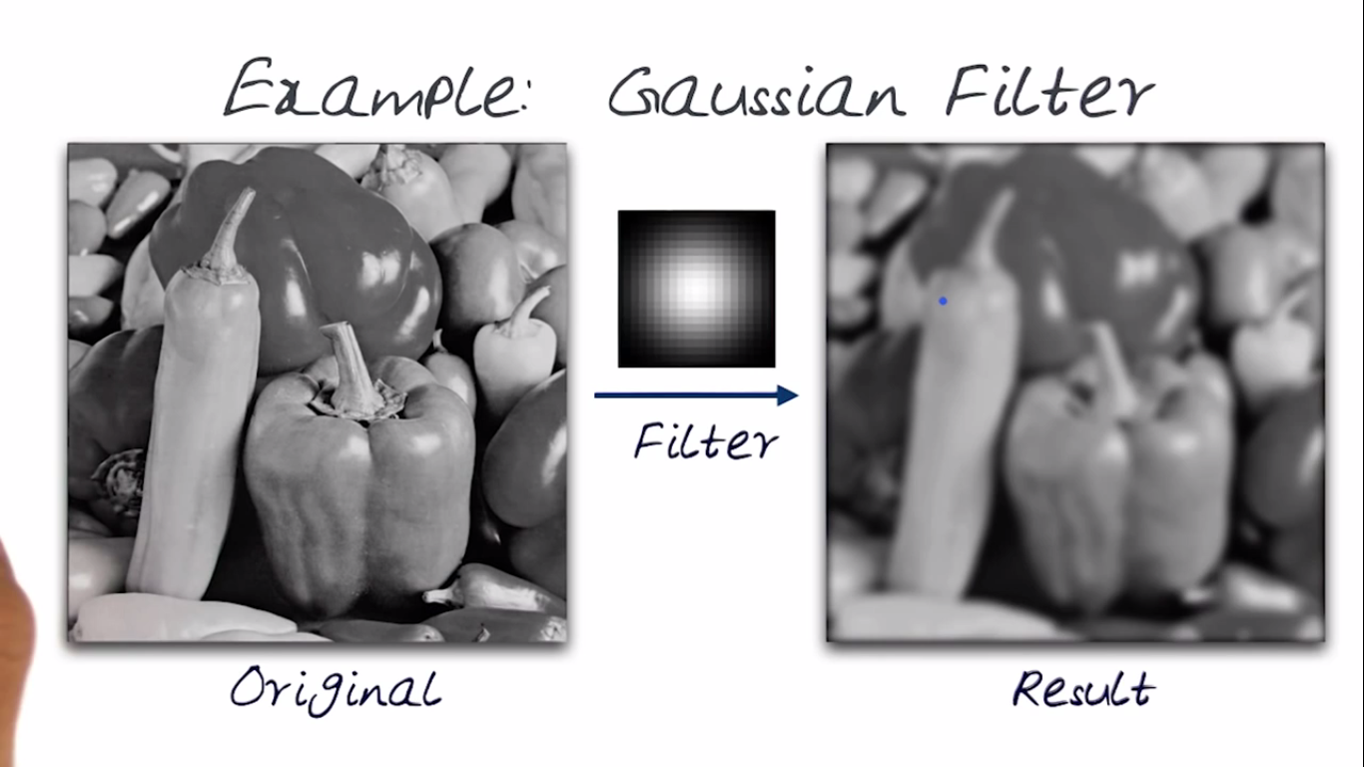

Slide 11
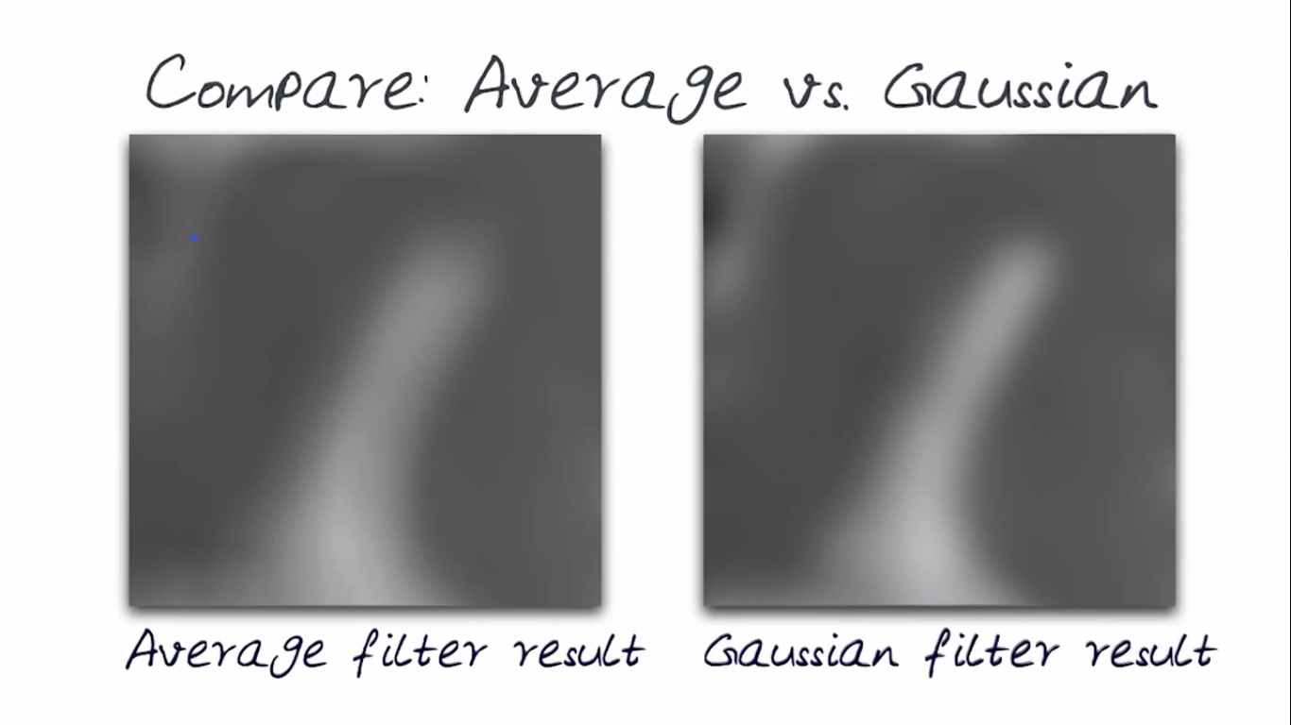

Slide 12
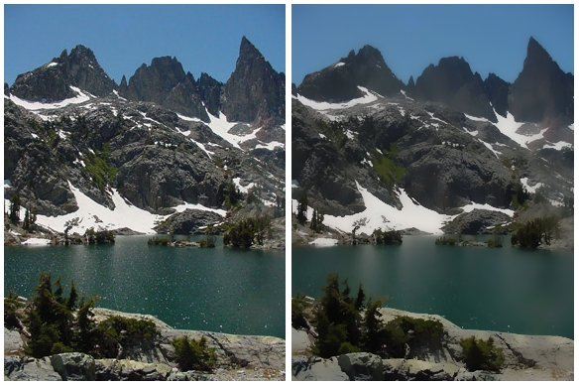
A bilateral filter is a non-linear, edge-preserving and noise-reducing smoothing filter for images The bilateral filter will produce
a more pleasant results, because it will avoid the introduction of blur between objects while still removing noise in uniform areas.

Slide 13
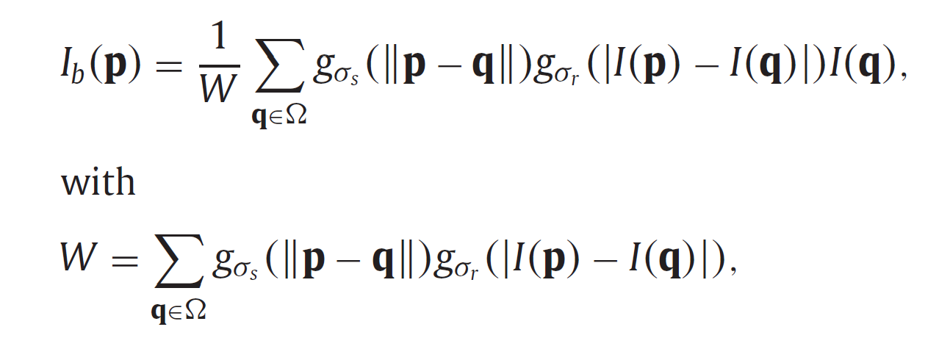
A Gaussian function denoted as gσ(x)=exp(−x2/σ2)
B = imgaussfilt(A,sigma)
filters image A with a 2-D Gaussian smoothing kernel with standard deviation specified by sigma.
The bilateral filtering of image I at pixel p is performed as:
where σ _{s} and σ _{r} are the standard deviations of the spatial and range Gaussians, which control the influences of neighbouring pixel q in terms of spatial and intensity differences.

Slide 14
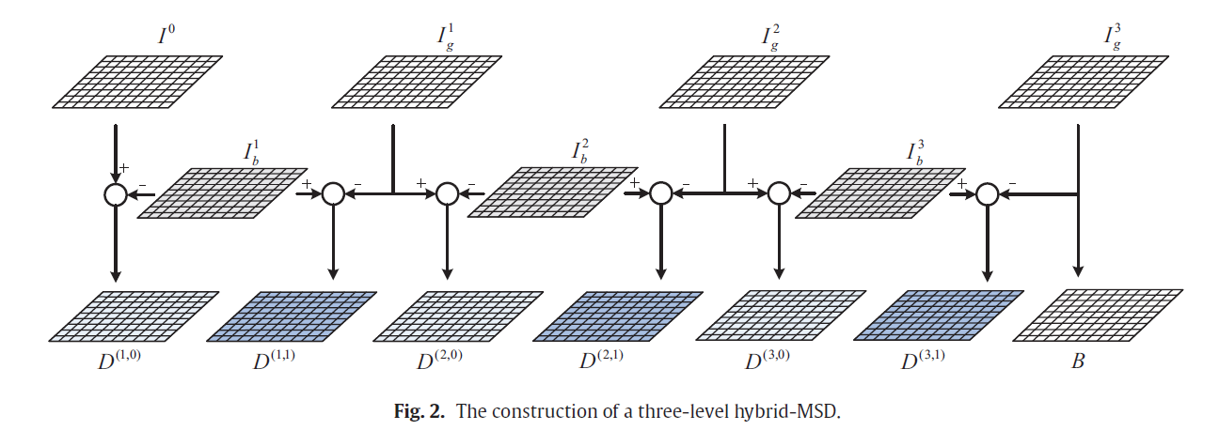

Slide 15
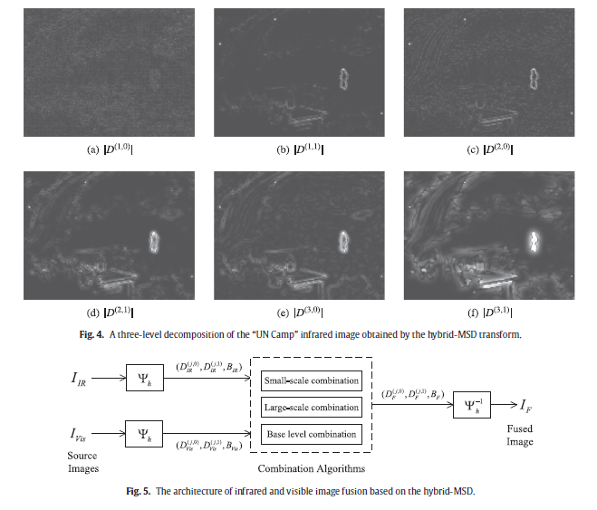
Department of Computer Science & Engineering, DSCE

Slide 16
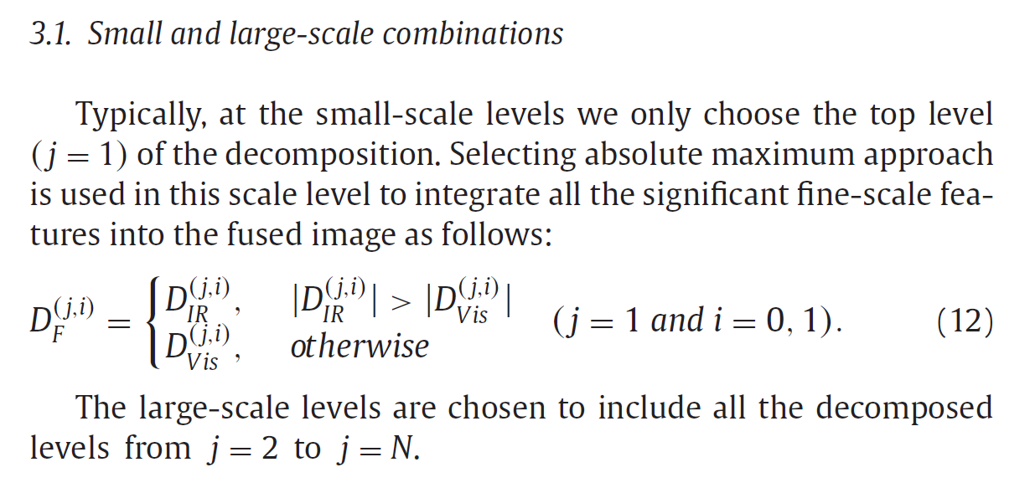
Department of Computer Science & Engineering, DSCE

Slide 17
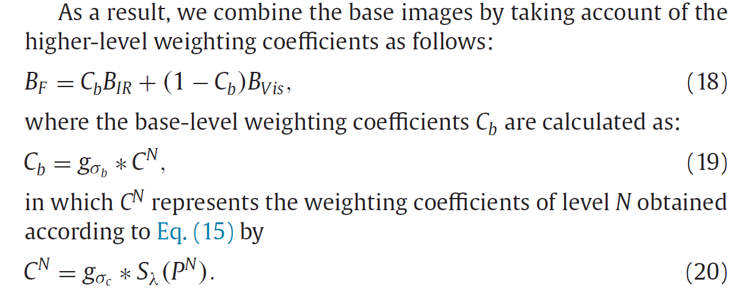
3.2.Baselevelcombination
Department of Computer Science & Engineering, DSCE

Slide 18
EXPERIMENTS AND RESULTS
The proposed fusion method was tested by subjective and objective assessments .
Various conventional pixel-level MSD-based fusion methods including the LAP ,GP ,DT-CWT and NSCT ( non-sub sampled contourlet transform )are compared in the experiments .
We use a four-level decomposition of the hybrid MSD, in which we set σs,0=2, σr,0=0.1.
The fusion results from the GP,LP, DT-CWT and NSCT methods are presented to be compared with that of the proposed method. We can see that the hybrid-MSD method successfully transfers the important IR spectral features into the fused image, while simultaneously the background and details from the visible image are also properly preserved. This results in a better visual fusion result compared with the fused images obtained by the ROLP, DT-CWT and NSCT methods.
Department of Computer Science & Engineering, DSCE

Slide 19
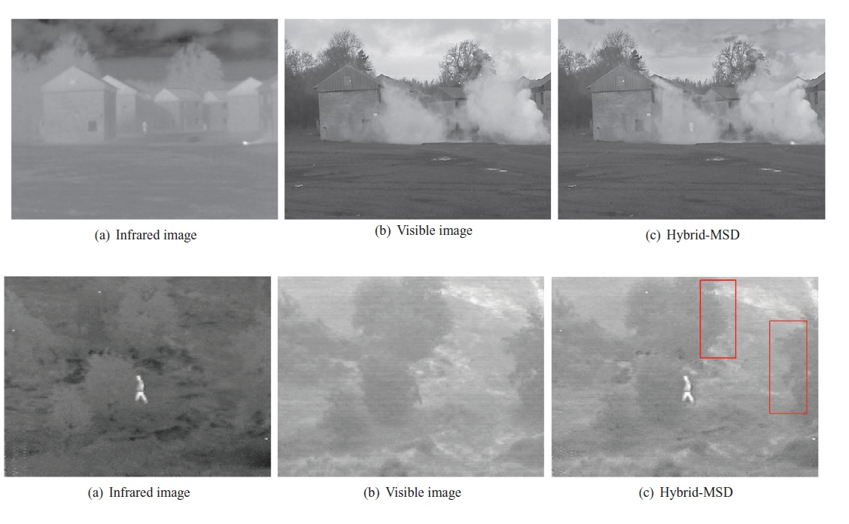

Slide 20
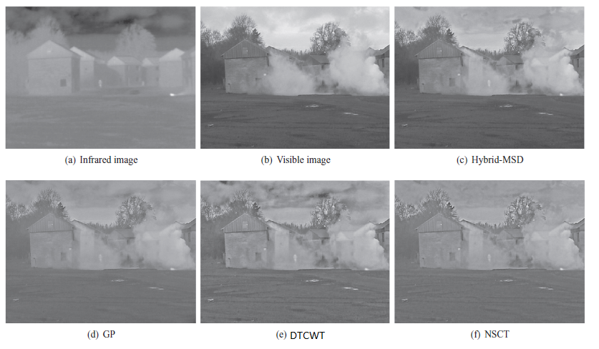
Comparison
GP- Gaussian Pyramid
LAP-Laplacian Pyramids
Dual-tree complex wavelet transform (DTCWT)
Non subsampled contourlet transform -NSCT

Slide 21
CONCLUSION
It can be used to identify and select important IR spectral features from the infrared image to inject them into the visible image.
By further employing different combination algorithms adaptively according to different information scale levels in the fusion process, we can preserve or properly enhance the background scenery and details from the visible image which provide important perceptual cues for human observation.
Experimental results demonstrate that the proposed fusion method is able to provide perceptually better fusion results compared with various other pixel-based multi-scale fusion algorithms.
Department of Computer Science & Engineering, DSCE

Slide 22
REFERENCES
Wei Gan, Xiaohong Wu, Wei Wu, Xiaomin Yang, Chao Ren, Xiaohai He, Kai Liu-"Infrared and visible image fusion with the use of multi-scale edge-preserving decomposition and guided image filter”-ELSEVIER Infrared Physics & Technology, Volume 72,Pages 37–51 September 2015,
Qiong Zhang , Xavier Maldague-"An adaptive fusion approach for infrared and visible images based on NSCT and compressed sensing"-ELSEVIER Infrared Physics & Technology, Volume 74,Pages 11–20, January 2016
Weiwei Kong , Binghe Wang , Yang Lei-"Technique for infrared and visible image fusion based on non-subsampled shearlet transform and spiking cortical model"-ELSEVIER Infrared Physics & Technology, Volume 71,Pages 87–98, July 2015
Department of Computer Science & Engineering, DSCE

Slide 23
REFERENCES (CONTINUED)
Chunhui Zhao , Yunting Guo, Yulei Wang-"A fast fusion scheme for infrared and visible light images in NSCT”-ELSEVIER Infrared Physics & Technology, Volume 72, Pages 266–275, September 2015
Zhiqiang Zhou, Bo Wang, Sun Li, Mingjie Dong-"Perceptual fusion of infrared and visible images through a hybrid multi-scale decomposition with Gaussian and bilateral filters"-ELSEVIER Information Fusion, Volume 30, Pages 15–26, July 2016,
Department of Computer Science & Engineering, DSCE

Slide 24
QUESTIONNAIRE
Department of Computer Science & Engineering, DSCE

Slide 25
THANK YOU
Department of Computer Science & Engineering, DSCE

